Slide 1
CS 575
Design and Analysis of
Computer Algorithms
Professor Michal Cutler
Graphs and traversals

Slide 2
Graph Algorithms
Graphs and Theorems about Graphs
Graph implementations
Graph traversals

Slide 3
What can graphs model?
Cost of wiring electronic components together.
Shortest route between two cities.
Finding the shortest distance between all pairs of cities in a road atlas.
Flow of material (liquid flowing through pipes, current through electrical networks, information through communication networks, parts through an assembly line, etc).
State of a machine.
Used in Operating systems to model resource handling (deadlock problems).
Used in compilers for parsing and optimizing the code.

Slide 4
What is a Graph?
Informally a graph is a set of nodes joined by a set of lines or arrows.
1
3
1
2
3
2
4
5
6
4
5
6

Slide 5
A directed graph, also called a digraph G is a pair ( V, E ), where the set V is a finite set and E is a binary relation on V .
The set V is called the vertex set of G and the elements are called vertices.
The set E is called the edge set of G and the elements are edges (also called arcs ).
A edge from node a to node b is denoted by the ordered pair ( a, b ).
Self loop
1
2
3
7
Isolated node
V = { 1, 2, 3, 4, 5, 6, 7 }
| V | = 7
4
5
6
E = { (1,2), (2,2), (2,4), (4,5), (4,1), (5,4),(6,3) }
| E | = 7

Slide 6
Undirected graph G = ( V , E ) , the edge set E consist of unordered pairs. Our text uses the notation
( a, b ) to refer to a directed edge, and
{ a, b } for an undirected edge.
V = { A, B, C, D, E, F }
|V | = 6
A
B
C
E = { {A, B}, {A,E}, {B,E}, {C,F} }
|E | = 4
D
E
F
Some texts use (a, b) also for undirected edges.
So ( a, b ) and ( b, a ) refers to the same edge.

Slide 7
Degree of a Vertex in an undirected graph is the number of edges incident on it. In a directed graph , the out degree of a vertex is the number of edges leaving it and the in degree is the number of edges entering it.
A
B
C
The degree of B is 2.
Self-loop
D
E
F
The in degree of 2 is 2 and
the out degree of 2 is 3.
1
2
4
5

Slide 8
Simple Graphs
Simple graphs are graphs without multiple (directed in same direction or undirected) edges connecting a single pair of vertices, or self-loops. We will consider only simple graphs.
Proposition: If G is an undirected graph then
Σ deg(v) = 2 |E |
Proposition: If G is a digraph then
Σ indeg(v) = Σ outdeg(v) = |E |
v ∈ V
v ∈ V
v ∈ V

Slide 9
A weighted graph is a graph for which each edge has an associated weight, usually given by a weight function w: E → R.
1.2
2
1
2
3
1
2
3
.2
.5
1.5
5
3
.3
1
4
5
6
4
5
6
.5

Slide 10
Paths
A path is a sequence of vertices such that there is an edge from each vertex to its successor.
A path is simple if each vertex is distinct.

Slide 11
Cyclic and Acyclic
A path from a vertex to itself is called a cycle
(e.g., v1 → v2 → v4 → v1)
If a graph contains a cycle, it is cyclic
Otherwise, it is acyclic
A path is simple if it never passes through the same vertex twice.
1
2
4
3

Slide 12
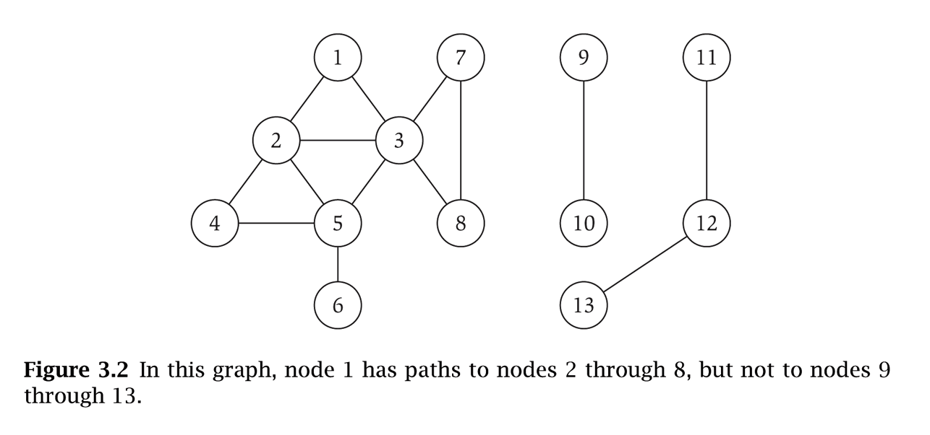
s-t Connectivity
s-t connectivity problem. Given two nodes s and t, is there a path between s and t?
s-t shortest path problem. Given two nodes s and t, what is the length of the shortest path between s and t?
Applications.
  Maze traversal.
  Kevin Bacon number.
  Fewest number of hops in a communication network.

Slide 13
Connectivity
An undirected graph is connected if any two nodes are connected by a path.
A directed graph is strongly connected if there is a directed path from any node to any other node.
A graph is sparse if | E | ≈ | V |
A graph is dense if | E | ≈ | V |²

Slide 14
Connected Component
Connected component. Find all nodes reachable from s.
Connected component containing node 1 = { 1, 2, 3, 4, 5, 6, 7, 8 }.

Slide 15

Flood Fill
Flood fill. Given lime green pixel in an image, change color of entire blob of neighboring lime pixels to blue.
  Node: pixel.
  Edge: two neighboring lime pixels.
  Blob: connected component of lime pixels.
recolor lime green blob to blue

Slide 16

Flood Fill
Flood fill. Given lime green pixel in an image, change color of entire blob of neighboring lime pixels to blue.
  Node: pixel.
  Edge: two neighboring lime pixels.
  Blob: connected component of lime pixels.
recolor lime green blob to blue

Slide 17
A Complete graph is an undirected/directed graph in which every pair of vertices is adjacent.
If (u, v ) is an edge in a graph G, we say that vertex v is adjacent to vertex u.
A
A
B
B
E
D
D
3 nodes and 3*2 edges
V nodes and V*(V-1) edges
Note: if self loops are allowed V² edges
4 nodes and (4*3)/2 edges
V nodes and V*(V-1)/2 edges
Note: if self loops are allowed V*(V-1)/2+V=V*(V+1)/2

Slide 18
A bipartite graph is an undirected graph G = (V,E) in which V can be partitioned into 2 sets V₁ and V₂ such that ( u,v) ∈E implies either u ∈V₁ and v ∈V₂ OR v ∈V₁ and u∈V_{2.}

Slide 19
Trees
A free tree is an acyclic, connected, undirected graph.
A forest is an acyclic undirected graph.
A rooted tree is a tree with one distinguished node, root.

Slide 20
Tree Definitions
Let G = (V, E ) be an undirected graph
G is a (free) tree if:.
1. G is acyclic and connected
2. Any two vertices in G are connected by unique simple path.
3. G is connected, but if any edge is removed from E, the resulting graph is disconnected.
4. G is connected, and | E | = | V | -1
5. G is acyclic, and | E | = | V | -1
G is a tree or a forest if:
G is undirected acyclic, but if any edge is added to E, the resulting graph contains a cycle.

Slide 21
Implementation of a Graph.
Adjacency-list representation of a graph G = ( V, E ) consists of an array ADJ of |V | lists, one for each vertex in V. For each u ∈ V , ADJ [ u ] points to all its adjacent vertices.
1
2
5
1
2
2
1
5
3
4
3
3
2
4
5
4
4
2
5
3
5
4
1
2

Slide 22
Adjacency-list representation for a directed graph.
1
2
5
1
2
2
5
3
4
3
3
4
5
4
4
5
5
5
Variation: Can keep a second list of edges coming into a vertex.

Slide 23
Adjacency lists
Advantage:
  Saves space for sparse graphs. Most graphs are sparse.
  “Visit” all edges that start at v
    Must traverse linked list of v
    Size of linked list of v is degree(v)
    θ(degree(v)) in the worst case
Disadvantage:
  Check for existence of an edge (v, u)
    Must traverse linked list of v
    Size of linked list of v is degree(v)
    θ(degree(v)) in the worst case

Slide 24
Adjacency Lists Storage
We need V pointers to linked lists
For a directed graph the number of nodes (or edges) contained (referenced) in all the linked lists is
Σ(out-degree (v)) = | E |. So Θ( V + E )
For an undirected graph the number of nodes is
Σ(degree (v)) = 2 | E |. Also Θ( V + E )
v ∈ V
v ∈ V

Slide 25
A |V | x |V | matrix A such that a_{ij} = 1 if (i, j ) ∈E and 0 otherwise.
Adjacency Matrix Representation for an undirected Graph
0
1
0 1 2 3 4
2
0
1
2
3
4
0 1 0 0 1
4
3
1 0 1 1 1
0 1 0 1 0
0 1 1 0 1
1 1 0 1 0

Slide 26
Adjacency Matrix Representation for a Directed Graph
0 1 2 3 4
0
1
0
1
2
3
4
0 1 0 0 1
0 0 1 1 1
2
0 0 0 1 0
4
3
0 0 0 0 1
0 0 0 0 0
Only outgoing edges are represented in upper diagonal

Slide 27
Adjacency Matrix Representation
Advantage:
  Saves space on pointers for dense graphs
  Check for existence of an edge (v, u)
    (adjacency [u] [v]) == 1?)
    So θ(1)
Disadvantage:
  “visit” all the edges that start at v
    Row v of the matrix must be traversed.
    So θ(|V|).

Slide 28
Graph traversals
Breadth first search
Depth first search

Slide 29
Some applications
Is G connected?
Does G contain a cycle?
Is G a tree?
Is G bipartite?
Find connected components
Topological sorting
Is directed G strongly connected?

Slide 30
Breadth first search
Given a graph G=(V,E) and a source vertex s, BFS explores the edges of G to “discover” (visit) each node of G reachable from s.
Idea - expand a frontier one step at a time.
Frontier is a FIFO queue (O(1) time to update)

Slide 31
Breadth first search
Computes the shortest distance (dist) from s to any reachable node.
Computes a breadth first tree (of parents) with roots that contains all the reachable vertices from s.
To get O(|V|+|E|) we use an adjacency list representation. If we used an adjacency matrix it would be Ο(|V|²)

Slide 32
Coloring the nodes
We use colors (white, gray and black) to denote the state of the node during the search.
A node is white if it has not been reached (discovered).
Discovered nodes are gray or black. Gray nodes are at the frontier of the search. Black nodes are fully explored nodes.

Slide 33
BFS - initialize
procedure BFS(G, s, color, dist, parent);
for each vertex u do
color[u]=white; dist[u]=∞; Θ(V)
 parent[u]=-1
color[s]=gray; dist[s]=0;
init(Q); enqueue(Q, s);

Slide 34
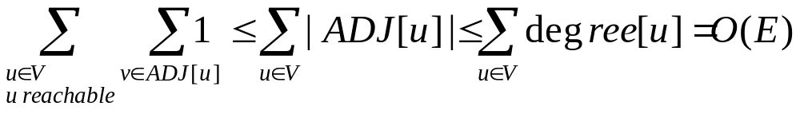
BFS - main
while not (empty(Q)) do
u:=head(Q);
for each v in adj[u] do
if (color[v]= =white) then O(E)
color[v]=gray; dist[v]=dist[u]+1;
parent[v]=u; enqueue(Q, v);
dequeue(Q); color[u]=black;
end BFS

Slide 35
Analysis of BFS
Initialization is Θ(|V|).
Each node can be added to the queue at most once (it needs to be white), and its adjacency list is searched only once. At most all adjacency lists are searched.
If graph is undirected each edge may be reached twice, so loop is repeated at most 2|E| times.
If graph is directed each edge may be reached exactly once. So the loop is repeated at most |E| times.
Worst case time O(|V|+|E|)

Slide 36
BFS example
r s t u r s t u
∞
0
∞
∞
1
0
∞
∞
s
w r
∞
∞
∞
1
∞
∞
∞
∞
v w x y v w x y
r s t u r s t u
1
0
2
∞
1
0
2
∞
r t x
t x v
∞
1
2
∞
2
1
2
∞
v w x y v w x y

Slide 37
BFS example
r s t u r s t u
0.
3
1
2
1
0
2
3
x v u
v u y
2
1
2
∞
2
1
2
3
v w x y v w x y
r s t u r s t u
1
0
2
3
1
0
2
3
u y
y
2
1
2
3
2
1
2
3
v w x y v w x y
Now y is removed from the Q and colored red

Slide 38
Depth First Search
Goal - explore every vertex and edge of G
We go “deeper” whenever possible.
Directed or undirected graph G = (V, E).
To get Θ(|V|+|E|) we use an adjacency list representation. If we used an adjacency matrix it would be Θ(|V|²)

Slide 39
Depth First Search
Until there are no more undiscovered nodes.
  Picks an undiscovered node and starts a depth first search from it.
  The search proceeds from the most recently discovered node to discover new nodes.
  When the last discovered node v is fully explored, backtracks to the node used to discover v. Eventually, the start node is fully explored.

Slide 40
Depth First Search
In this version all nodes are discovered even if the graph is directed, or undirected and not connected
The algorithm saves:
  A depth first forest of the edges used to discover new nodes.
  Timestamps for the first time a node u is discovered d[u] and the time when the node is fully explored f[u]

Slide 41
DFS
DFS(G, color, d, f, parent);
//Loop is Θ(V)
for each vertex u do
color[u]=white; parent[u]=-1; time=0;
// Loop is Θ(V) excluding the time for recursive calls
  for each vertex u do
if (color[u]==white) then
DFS-Visit(u)
end DFS

Slide 42
DFS-Visit(u)
color[u]=gray; time=time+1; d[u]=time
//Loop is Θ(|adj[u]|) excluding the time for the
// recursive calls
for each v in adj[u] do
if (color[v]==white) then
parent[v]=u; DFS-Visit(v);
color[u]=black; time=time+1;
f[u]=time;
end DFS-Visit

Slide 43
Analysis
DFS is Θ(|V|) (excluding the time taken by the DFS-Visits).
DFS-Visit is called once for each node v. Its for loop is executed |adj(v)| times. The DFS-Visit calls for all the nodes take Θ(|E|).
Worst case time Θ(|V|+|E|)

Slide 44
DFS example (1)
u v w
u v w
1/
1/
2/
x y z
x y z
u v w
u v w
1/
2/
1/
2/
B
3/
4/
3/
x y z
x y z
An edge to a grey node is a back edge

Slide 45
DFS example (2)
u v w
u v w
1/
2/
1/
2/
B
B
x y z
4/5
3/
4/5
3/6
x y z
u v w
1/
2/7
B
4/5
3/6
x y z

Slide 46
DFS example (3)
An edge to a black node that was discovered later is a forward edge
u v w
u v w
1/8
2/7
1/8
2/7
9
F
B
F
B
C
4/5
3/6
4/5
3/6
x y z
x y z
u v w
u v w
1/8
2/7
9
1/8
2/7
9
F
B
C
B
F
C
4/5
3/6
10
3/6
x y z
4/5
10/11
x y z

Slide 47
DFS example (4)
An edge to a black node that was discovered before the node was discovered is a cross edge
u v w
1/8
2/7
9/12
F
B
C
4/5
3/6
10/11
x y z
When the graph is undirected all edges are either a tree edge or a back edge

Slide 48
Some applications
Is undirected G connected? Change DFS to call dfsVisit(v) only once, and then to check if there are still white nodes.
Ο(V + E)
Find connected components. Call DFS. The nodes discovered in each call from DFS to dfsVisit(v) belong to a single component. Θ(V+E)

Slide 49
Labeling the edges (digraph)
Tree edges - those belonging to the forest
Back edges - edges from a node to an ancestor in the tree.
Forward edges - a non tree edge from a node to a descendant in the tree.
Cross edges - the rest of the edges, between trees and subtrees
When a graph is undirected its edges are tree or back edges for DFS, tree or cross for BFS

Slide 50
Classifying edges of a digraph
(u, v) is:
  Tree edge – if v is white
  Back edge – if v is gray
  Forward or cross - if v is black
(u, v) is:
  Forward edge – if v is black and d[u] < d[v] (v was discovered after u)
  Cross edge – if v is black and d[u] > d[v] (u discovered after v)

Slide 51
More applications
Does directed G contain a directed cycle? Do DFS if back edge return yes, otherwise no. Time O(V+E).
Does undirected G contain a cycle? Same algorithm as directed but be careful not to consider (u,v) and (v, u) a cycle.
If graph is a tree or a forest it can have at most |V|-1 distinct edges. Time O(V) since encounter at most |V| edges (if (u, v) and (v, u) are counted as one edge), before cycle is found.
Is undirected G a tree? DFS with one call to dfsVisit(v). If all vertices are reached and no back edges G is a tree. O(V)

Slide 52
Topological Sort
A topological order of a directed acyclic graph G = (V, E) is an ordering of its nodes as v₁, v₂, …, v_{n} so that for every edge (v_{i}, v_{j}) we have i < j.
v₂
v₃
v₆
v₅
v₄
v₁
v₂
v₃
v₄
v₅
v₆
v₇
v₇
v₁
a DAG
a topological ordering

Slide 53
Topological sort
Applications.
Course prerequisite graph: course v_{i} must be taken before v_{j}.
Compilation: module v_{i} must be compiled before v_{j}.
Pipeline of computing jobs: output of job v_{i} needed to determine input of job v_{j}.

Slide 54
Topological sort algorithm
Given a DAG G
TOPOLOGICAL-SORT(G)
Apply DFS(G)
As each vertex is finished insert it at the front of a list
return the list

Slide 55
Second algorithm
Lemma. If G is a DAG, then G has a source node.
Proof (by contradiction)
  Suppose that G is a DAG and every node has at least one incoming edge.
  Pick any node v, and begin following edges backward from v. Since v has at least one incoming edge (u, v) we can walk backward to u.
  Then, since u has at least one incoming edge (x, u), we can walk backward to x.
  Repeat until we visit a node, say w, twice.
  Let C denote the sequence of nodes encountered between successive visits to w. C is a cycle. ▪
w
x
u
v

Slide 56
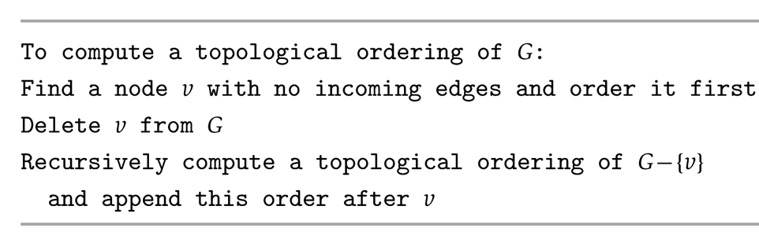
Second algorithm
Lemma. If G is a DAG, then G has a topological ordering.
Pf. (by induction on n)
  Base case: true if n = 1.
  Given DAG on n > 1 nodes, find a node v with no incoming edges.
  G - { v } is a DAG, since deleting v cannot create cycles.
  By inductive hypothesis, G - { v } has a topological ordering.
  Place v first in topological ordering; then append nodes of G - { v }in topological order.
  This is valid since v has no incoming edges. ▪

Slide 57
Second Algorithm
Maintain the following information:
  count[w] = remaining number of incoming edges
  S = set of remaining nodes with no incoming edges
Initialization: Θ(V + E) via single scan through graph.
Update: to delete source v in S
    remove v from S
    decrement count[w] for all edges from v to w, and add w to S if count[w] hits 0
Each node v will become a source and be deleted. Each deletion takes time Θ(ADJ[v])
So |V| updates take time Θ(V+E)
Notes:
Alternative. Order nodes in reverse order that DFS finishes visiting them.

Slide 58
Strong Connectivity: Algorithm
Determine if G is strongly connected in Θ(V + E) time.
Pick any node s.
Run BFS from s in G.
Run BFS from s in G^{rev}.
Return true iff all nodes reached in both BFS executions.
reverse orientation of every edge in G
u cannot reach v
v
u
strongly connected
not strongly connected
Notes:
Theorem. [Tarjan 1972] Can decompose a graph into its
"strong components" in O(m + n) time.

Slide 59
Strong Connectivity: Algorithm
A directed graph is strongly connected if every pair of nodes u and v are mutually reachable.
Can determine if G is strongly connected in O(m + n) time.
Procedure:
  Pick any node s.
  Run BFS from s in G.
  Run BFS from s in G^{rev}.
  Return true iff all nodes reached in both BFS executions.
reverse orientation of every edge in G
strongly connected
not strongly connected
Notes:
Theorem. [Tarjan 1972] Can decompose a graph into its
"strong components" in O(m + n) time.

Slide 60
Topological Sort
A topological order of a directed acyclic graph G = (V, E) is an ordering of its nodes as v₁, v₂, …, v_{n} so that for every edge (v_{i}, v_{j}) we have i < j.
v₂
v₃
v₆
v₅
v₄
v₁
v₂
v₃
v₄
v₅
v₆
v₇
v₇
v₁
a DAG
a topological ordering

Slide 61
Topological sort
Applications.
Course prerequisite graph: course v_{i} must be taken before v_{j}.
Compilation: module v_{i} must be compiled before v_{j}.
Pipeline of computing jobs: output of job v_{i} needed to determine input of job v_{j}.

Slide 62
Topological sort algorithm
Given a DAG G
TOPOLOGICAL-SORT(G)
Apply DFS(G)
As each vertex is finished insert it at the front of a list
return the list

Slide 63
Second algorithm
Lemma. If G is a DAG, then G has a source node.
Proof (by contradiction)
  Suppose that G is a DAG and every node has at least one incoming edge.
  Pick any node v, and begin following edges backward from v. Since v has at least one incoming edge (u, v) we can walk backward to u.
  Then, since u has at least one incoming edge (x, u), we can walk backward to x.
  Repeat until we visit a node, say w, twice.
  Let C denote the sequence of nodes encountered between successive visits to w. C is a cycle. ▪
w
x
u
v

Slide 64
Second algorithm
Lemma. If G is a DAG, then G has a topological ordering.
Pf. (by induction on n)
  Base case: true if n = 1.
  Given DAG on n > 1 nodes, find a node v with no incoming edges.
  G - { v } is a DAG, since deleting v cannot create cycles.
  By inductive hypothesis, G - { v } has a topological ordering.
  Place v first in topological ordering; then append nodes of G - { v }in topological order.
  This is valid since v has no incoming edges. ▪

Slide 65
Second Algorithm
Maintain the following information:
  count[w] = remaining number of incoming edges
  S = set of remaining nodes with no incoming edges
Initialization: Θ(V + E) via single scan through graph.
Update: to delete source v in S
    remove v from S
    decrement count[w] for all edges from v to w, and add w to S if count[w] hits 0
Each node v will become a source and be deleted. Each deletion takes time Θ(ADJ[v])
So |V| updates take time Θ(V+E)
Notes:
Alternative. Order nodes in reverse order that DFS finishes visiting them.

Slide 66
Strong Connectivity: Algorithm
Determine if G is strongly connected in Θ(V + E) time.
Pick any node s.
Run BFS from s in G.
Run BFS from s in G^{rev}.
Return true iff all nodes reached in both BFS executions.
reverse orientation of every edge in G
u cannot reach v
v
u
strongly connected
not strongly connected
Notes:
Theorem. [Tarjan 1972] Can decompose a graph into its
"strong components" in O(m + n) time.

Slide 67
Topological Sort
A topological order of a directed acyclic graph G = (V, E) is an ordering of its nodes as v₁, v₂, …, v_{n} so that for every edge (v_{i}, v_{j}) we have i < j.
v₂
v₃
v₆
v₅
v₄
v₁
v₂
v₃
v₄
v₅
v₆
v₇
v₇
v₁
a DAG
a topological ordering

Slide 68
Topological sort
Applications.
Course prerequisite graph: course v_{i} must be taken before v_{j}.
Compilation: module v_{i} must be compiled before v_{j}.
Pipeline of computing jobs: output of job v_{i} needed to determine input of job v_{j}.

Slide 69
Topological sort algorithm
Given a DAG G
TOPOLOGICAL-SORT(G)
Apply DFS(G)
As each vertex is finished insert it at the front of a list
return the list

Slide 70
Second algorithm
Lemma. If G is a DAG, then G has a source node.
Proof (by contradiction)
  Suppose that G is a DAG and every node has at least one incoming edge.
  Pick any node v, and begin following edges backward from v. Since v has at least one incoming edge (u, v) we can walk backward to u.
  Then, since u has at least one incoming edge (x, u), we can walk backward to x.
  Repeat until we visit a node, say w, twice.
  Let C denote the sequence of nodes encountered between successive visits to w. C is a cycle. ▪
w
x
u
v

Slide 71
Second algorithm
Lemma. If G is a DAG, then G has a topological ordering.
Pf. (by induction on n)
  Base case: true if n = 1.
  Given DAG on n > 1 nodes, find a node v with no incoming edges.
  G - { v } is a DAG, since deleting v cannot create cycles.
  By inductive hypothesis, G - { v } has a topological ordering.
  Place v first in topological ordering; then append nodes of G - { v }in topological order.
  This is valid since v has no incoming edges. ▪

Slide 72
Second Algorithm
Maintain the following information:
  count[w] = remaining number of incoming edges
  S = set of remaining nodes with no incoming edges
Initialization: Θ(V + E) via single scan through graph.
Update: to delete source v in S
    remove v from S
    decrement count[w] for all edges from v to w, and add w to S if count[w] hits 0
Each node v will become a source and be deleted. Each deletion takes time Θ(ADJ[v])
So |V| updates take time Θ(V+E)
Notes:
Alternative. Order nodes in reverse order that DFS finishes visiting them.

Slide 73
Algorithm for Strong Connectivity
A directed graph is strongly connected if every pair of nodes is mutually reachable
Determine if G is strongly connected in Θ(V + E) time.
  Pick any node s.
  Run BFS from s in G and check that every node is reached.
  Run BFS from s in G^{rev} and check that every node is reached.
  Return true iff all nodes reached in both BFS executions.
u cannot reach v
v
u
strongly connected
not strongly connected
Notes:
Theorem. [Tarjan 1972] Can decompose a graph into its
"strong components" in O(m + n) time.

Slide 74
Algorithm for Strong Connectivity
The first BFS establishes that there is a directed path from s to every other node
The second that there is a directed path from s to every other node in the reverse graph
This means that there is a directed path from every node to s
The following lemma shows that every pair of nodes u and v are mutually reachable

Slide 75
Algorithm for Strong Connectivity
Lemma
If u and s are mutually reachable and s and w are mutually reachable then u and w are mutually reachable
Proof: Go from u to s and then from s to w and you have a path from u to w. Go from w to s and from s to u and you have a path from w to u

